Slide 1
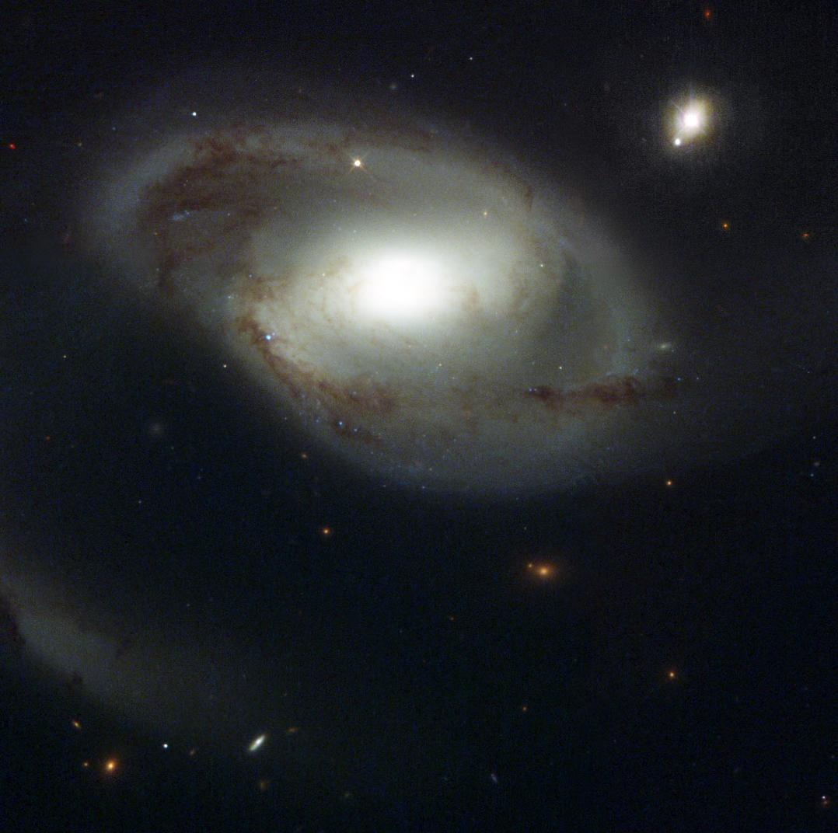
Tracing the Circumgalactic Medium with the Cosmic Origins Spectrograph
David M. French
Advisor: Bart Wakker
University of Wisconsin - Madison
April 25, 2016
Image Credit: NASA and The Hubble Heritage Team (STScI/AURA)

Slide 2
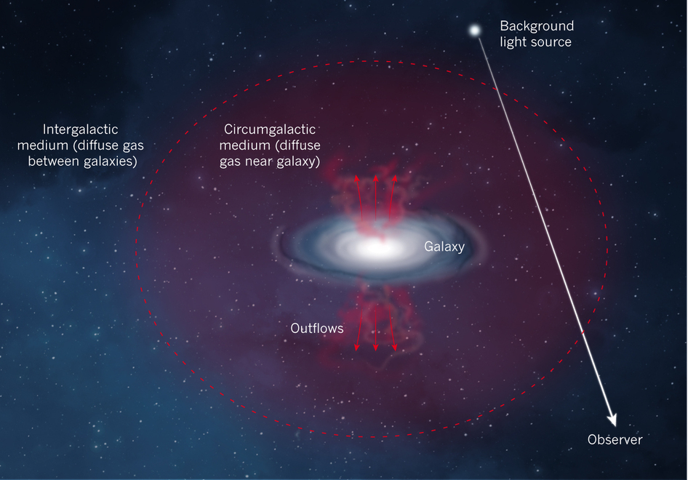
Defining the CGM
Nature 517, 444
Notes:
Put one of these first

Slide 3
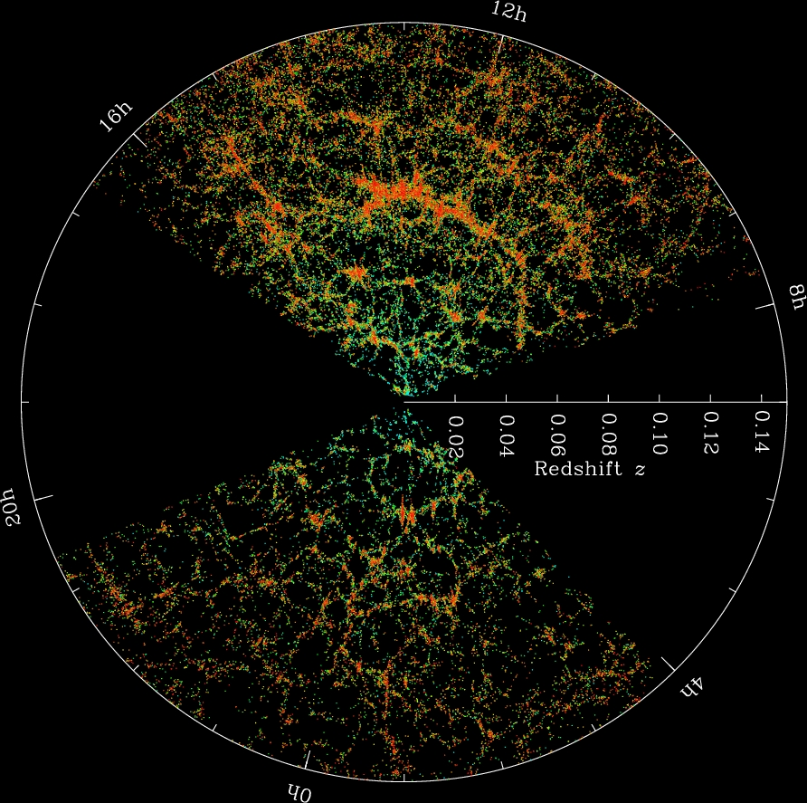
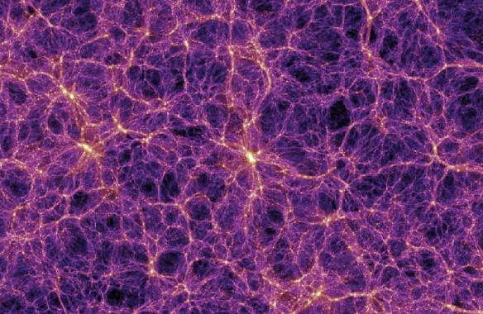
Gas in the Universe
The Millenium Simulation
SDSS Collaboration
Notes:
Gas collapsed with DM into filaments = cosmic web, formed galaxies

Slide 4
The gas nearby galaxies
Gas and galaxies both follow DM potential
Do they “know” about each other?
Notes:
Gas and galaxies both follow the DM potential, but how do the interact?

Slide 5
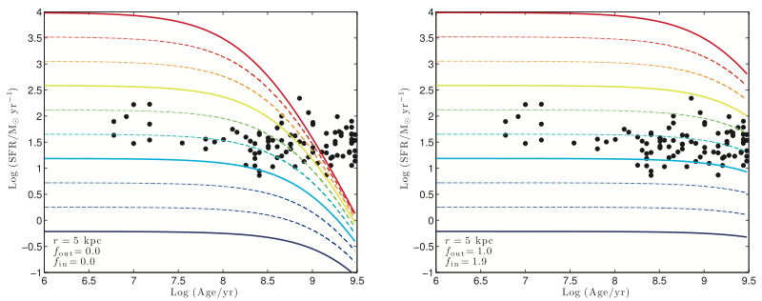
Accretion required
With no accretion
With accretion
SFR
SFR
AGE
AGE
Erb 2008
Notes:
LEFT: Closed box.
RIGHT: Outflow rate = SFR, inflow rate = 1.9*SFR

Slide 6
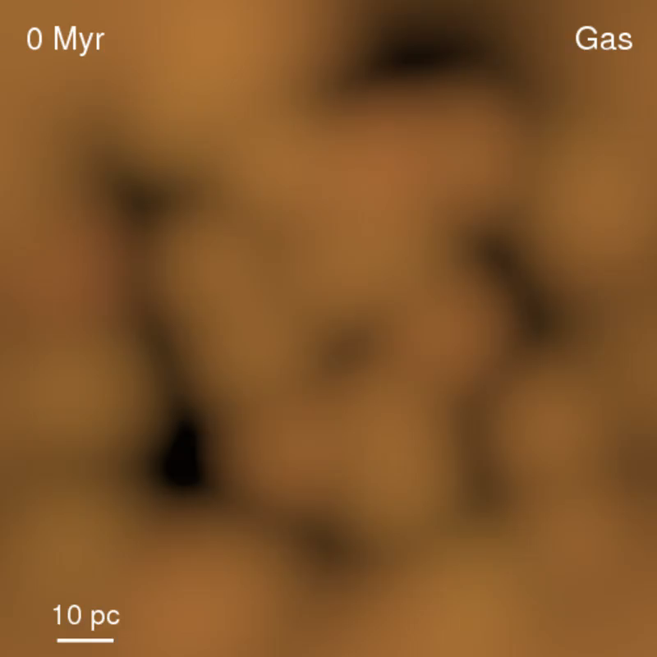
Outflows and feedback
Hopkins et al. 2012
Notes:
Galaxies still arranged in filaments, makes sense for gas to still be there too.

Slide 7
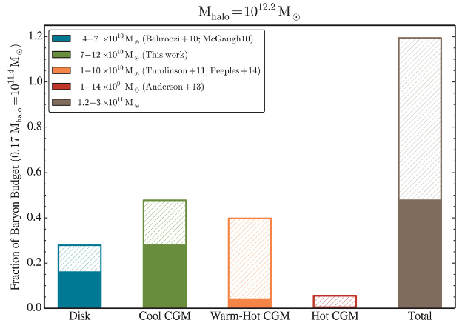
Baryon Budget
Werk et al. 2014, ApJ, 792, 128
Notes:
Green -> Lya (T = 10^4), Orange -> OVI (T = 10^5 – 10^7), Red -> X-rays (T>10^7)

Slide 8
Understanding the CGM
Galaxies need to continue accreting gas over cosmic time to match observations
Feedback kicks gas out of galaxies

Slide 9
Understanding the CGM
Galaxies need to continue accreting gas over cosmic time to match observations
Feedback kicks gas out of galaxies
How is the halo gas kinematically connected to and associated with the galaxies?
My project will concentrate on neutral HI -> Lyα absorption

Slide 10
Outline
Methods
Four open questions:
Rotation
Inclination/azimuth angle
Environment
Group vs field galaxies
Project overview
Pilot study
Schedule

Slide 11
Defining the CGM
Impact parameter (ρ)
Nature 517, 444
Notes:
Put one of these first

Slide 12
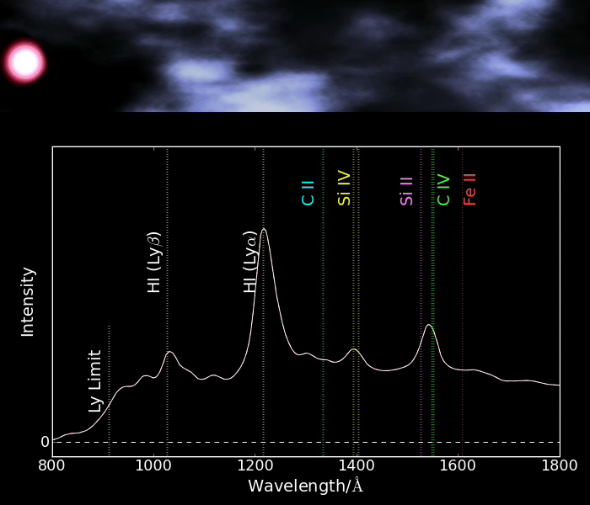
Method

Slide 13
Four Open Questions

Slide 14

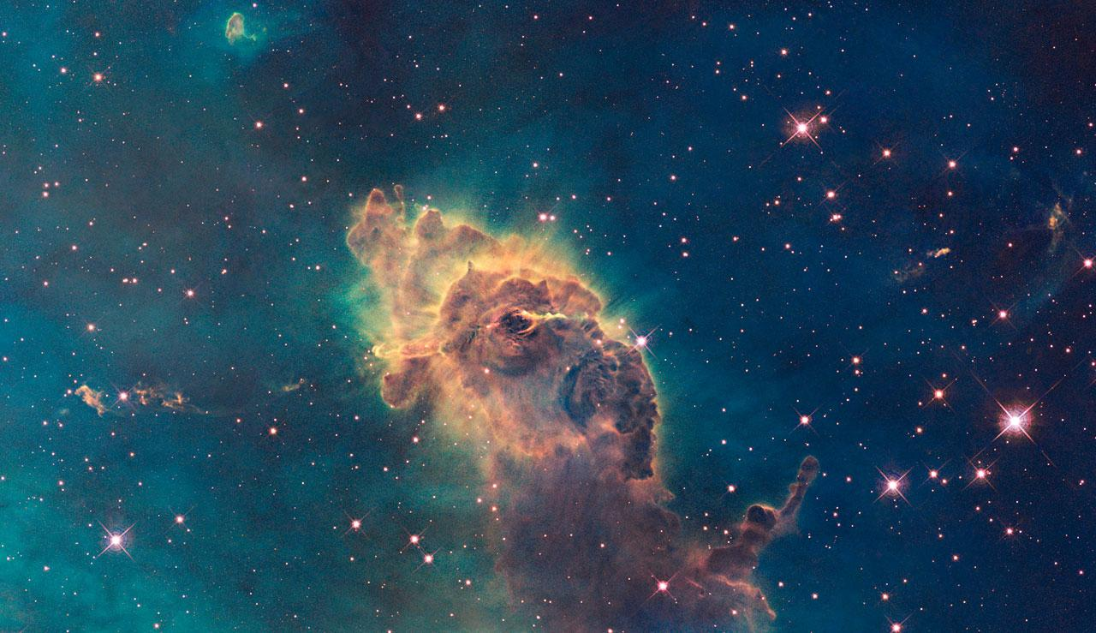
Does the CGM gas rotate with the galaxies?
?
R. Hurt, JPL, NASA & GLIMPSE Team

Slide 15
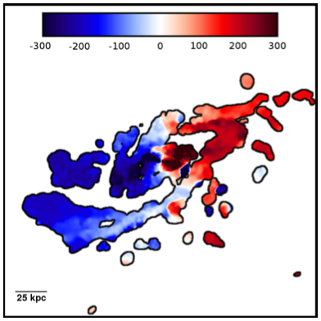
Does the CGM gas rotate with the galaxies?
Simulations say: yes!
Velocity
Stewart et al. 2011
Notes:
Line of sight velocity of cool gas in a halo at z = 1.4. Image width = 200 comoving kpc. View at inclination = 75
LABEL THE COLOR BAR

Slide 16
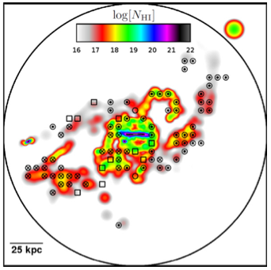
Does the CGM gas rotate with the galaxies?
Simulations say: yes!
QSO sightlines through the halo should be able to trace this
Stewart et al. 2011
Notes:
Line of sight velocity of cool gas in a halo at z = 1.4. Image width = 200 comoving kpc. View at inclination = 75
NOT THIS MANY SIGHTLINES IN REALTY

Slide 17
Does the CGM gas rotate with the galaxies?
Simulations say: Yes!
Observations: Unclear
Wakker & Savage 2009
– sample of 4, no correlation
Notes:
Wakker & Savage had a sample of 4 galaxies with known rotation and an associated absorber – 1 followed, 1 was opposite, 2 others had small delta-v

Slide 18
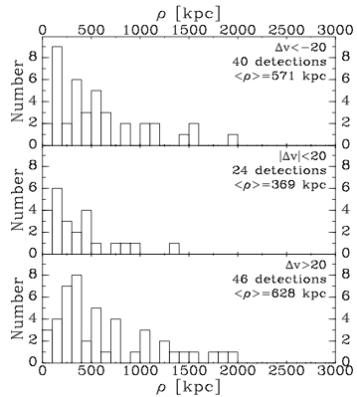
Does the CGM gas rotate with the galaxies?
Simulations say: Yes!
Observations: Unclear
Wakker & Savage 2009 – sample of 4
Closer absorbers have smaller Δv
Δv = v(galaxy) – v(gas)
Wakker & Savage 2009
Notes:
DEFINE DELTA -V

Slide 19
Does the CGM gas rotate with the galaxies?
Simulations say: Yes!
Observations: Unclear
Wakker & Savage 2009 – sample of 4
Questions:
Define CGM vs. IGM?
To what distances?
REQUIRES A LARGER SAMPLE
Wakker & Savage 2009
Notes:
Wakker

Slide 20
How do CGM gas properties depend on galaxy inclination or orientation?
Notes:
Define inclination and orientation

Slide 21
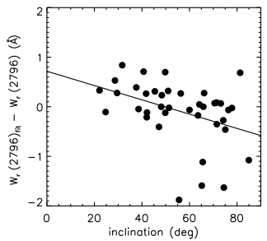
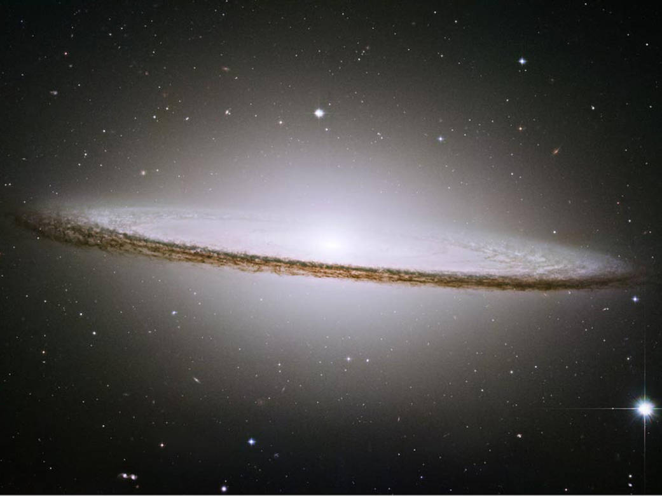
How do CGM gas properties depend on galaxy inclination?
Maybe?
MgII W (mÅ)
Kacprzak et al. 2011
Notes:
Kacprzak claims a correlation between inclination and equivalent width – halo gas has a co-planar geometry and is coupled to the disk inclination.
Y-axis: EW residuals computed from the fit between EW vs impact parameter
BLURRY

Slide 22
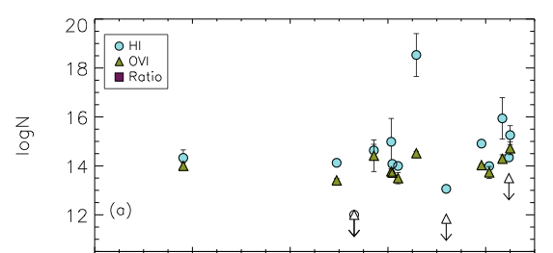
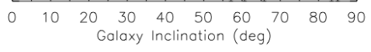
How do CGM gas properties depend on galaxy inclination?
No?
Not enough data to tell
Existing data incomplete
Mathes et al. 2014
Notes:
TAKE OFF THE BOTTOM PART

Slide 23
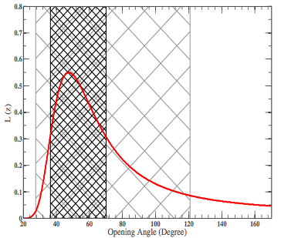
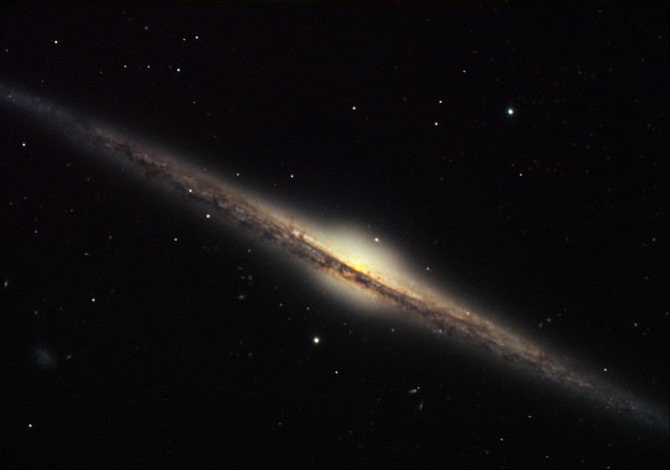
How do CGM gas properties depend on galaxy orientation?
Major vs minor?
Bordoloi et al. 2014 predict 45° opening angle for MgII
Fraction of MgII absorbers
Credit: Bruce Hugo & Leslie Gaul, Adam Block, NOAO, AURA, NSF
Opening angle
Bordoloi et al. 2014, ApJ, 784, 108
Notes:
AXIS LABELS, DEFINE THE DIFFERENCE BETWEEN ORIENTATIONS AND INCLINATIONS

Slide 24
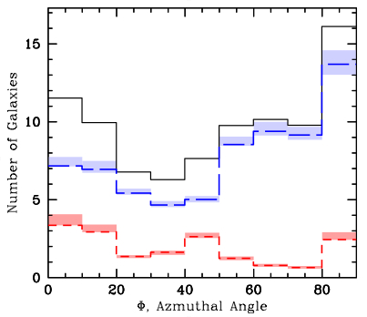
How do CGM gas properties depend on galaxy orientation?
Kacprzak et al 2012 find bimodal MgII absorption
Blue = late type
Red = early type
QSO
Major axis
Minor axis
Credit: Bruce Hugo & Leslie Gaul, Adam Block, NOAO, AURA, NSF
Kacprzak et al. 2012
Notes:
Black is total, red is red galaxies (early type), blue is blue galaxies (late type)
LABEL ON THE PLOT “MINOR” AND “MAJOR” AXIS

Slide 25
How do CGM gas properties depend on galaxy orientation?
Major vs minor?
Same for neutral gas?
QSO
Credit: Bruce Hugo & Leslie Gaul, Adam Block, NOAO, AURA, NSF
Kacprzak et al. 2012

Slide 26
What is the influence of nearby galaxies on the CGM gas properties?

Slide 27
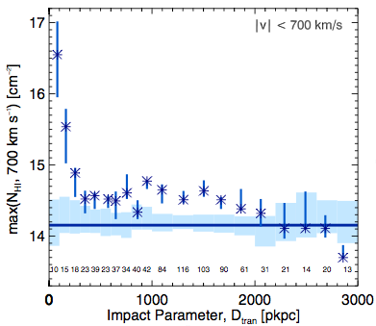
What is the influence of nearby galaxies on the CGM gas properties?
Rudie et al. 2012 find elevated N_{HI} out to 2 Mpc from galaxies at z = 2
Other groups measure larger Lyα equivalent widths closer to galaxies
Rudie et al. 2012

Slide 28
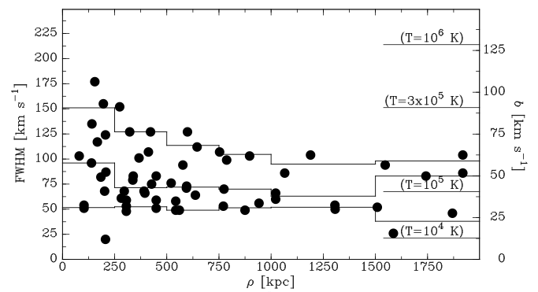
What is the influence of nearby galaxies on the CGM gas properties?
Wakker & Savage 2009 find Lyα FWHM anti-correlates with impact parameter at z = 0.015
Cause?
Galaxy properties?
Wakker, B.P., Savage, B.D., 2009, ApJS, 182, 378
Notes:
Several other studies have also found EW to anti-correlate as well

Slide 29
Is there a difference in CGM gas properties between field and group galaxies?

Slide 30
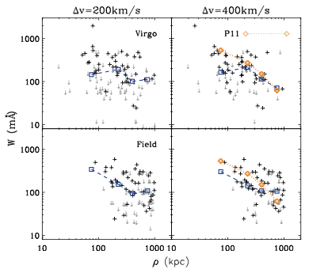
Are CGM gas properties different around field vs group galaxies?
Yoon & Putman find no W – ρ correlation in the Virgo Cluster
Lyα W (mÅ)
Impact parameter (kpc)
Yoon & Putman 2013
Notes:
Equivalent width – impact parameter correlation disappears in the Virgo Cluster environment. Hints at CGM suppression in cluster environments. How about smaller groups?
TAKE OFF THE RIGHT SIDE – SPECIFY LYALPHA

Slide 31
Are CGM gas properties different around field vs group galaxies?
Yoon & Putman find no W – ρ correlation in the Virgo Cluster
What about in smaller groups?
Lyα W (mÅ)
Impact parameter (kpc)
Yoon & Putman 2013
Notes:
Equivalent width – impact parameter correlation disappears in the Virgo Cluster environment. Hints at CGM suppression in cluster environments. How about smaller groups?
TAKE OFF THE RIGHT SIDE – SPECIFY LYALPHA

Slide 32
Are CGM gas properties different around field vs group galaxies?
Yoon & Putman find no W – ρ correlation in the Virgo Cluster
Wakker & Savage find fewer Lyα absorbers near galaxy groups
Used outdated group catalogs
New group catalogs (e.g. Tully 2015) necessitate a reevaluation
Membership dependence?
Lyα W (mÅ)
Impact parameter (kpc)
Yoon & Putman 2013
Notes:
Equivalent width – impact parameter correlation disappears in the Virgo Cluster environment. Hints at CGM suppression in cluster environments. How about smaller groups?
TAKE OFF THE RIGHT SIDE – SPECIFY LYALPHA

Slide 33
Problems with existing studies
Limited scope (CGM – IGM interface?)
?
Nature 517, 444
Notes:
Other studies max out at 300 kpc because of the telescope aperture diameter, this is approximately the boundary between the CGM and IGM
MAKE THE STRONGER POINT ABOUT IMPACT PARAMETERS

Slide 34
Problems with existing studies
Recall: Elevated N(HI) → 2 Mpc!
Rudie et al. 2012
Notes:
Other studies max out at 300 kpc because of the telescope aperture diameter, this is approximately the boundary between the CGM and IGM
MAKE THE STRONGER POINT ABOUT IMPACT PARAMETERS

Slide 35
Problems with existing studies
Limited scope (hard impact parameter limits)
Can’t probe the CGM-IGM boundary!
Incomplete galaxy sample (e.g. only L* or brighter)
Little information on galaxy kinematics (e.g. rotation)
Small sample sizes (e.g. 10’s of systems)

Slide 36
Increasing the sample size
300+ archival COS quasar sightlines

Slide 37
Increasing the sample size
300+ archival COS quasar sightlines
Redshift limit: cz = 10,000 km/s
Faint galaxies:
97% of absorbers found within 400 kpc of a 0.1L* galaxy in nearby Universe (Wakker & Savage 2009)

Slide 38
Increasing the sample size
300+ archival COS quasar sightlines
Redshift limit: cz = 10,000 km/s
Faint galaxies:
97% of absorbers found within 400 kpc of a 0.1L* galaxy in nearby Universe (Wakker & Savage 2009)
Better statistics: 400+ galaxy - absorber systems
Search for all absorber systems within 400 km/s and 2 Mpc of galaxies, and vice-versa
Notes:
Average of 5 lya absorbers per sightline,

Slide 39
Search around galaxies first
Search for galaxies around absorbers, or absorbers around galaxies?
Wakker & Savage (2009):
50% of absorbers have galaxies within 400 kpc
97% of galaxies have absorbers within 400 kpc
Need a dataset of ALL galaxies within survey volume

Slide 40
Compiling a galaxy dataset
The NASA Extragalactic Database (NED)
Over 100,000 galaxies with cz <10,000 km/s
Includes SDSS, 2MASS, 2dF, 6dF, and many smaller datasets
I have obtained:
positions
redshifts
diameters
morphology
redshift-independent distance
inclination
position angle
photometry
etc…
Homogenize data

Slide 41
Compiling a galaxy dataset
Homogenize data:
Normalize diameters to 2MASS values
Compute L/L* ratios based on photometry

Slide 42
Ex: Normalize diameters to 2MASS
K_{s} 2MASS Diameters
RC3 diameters
French et al. in prep
Notes:
Explain this better (thought experiment or an example) and fix the labels

Slide 43
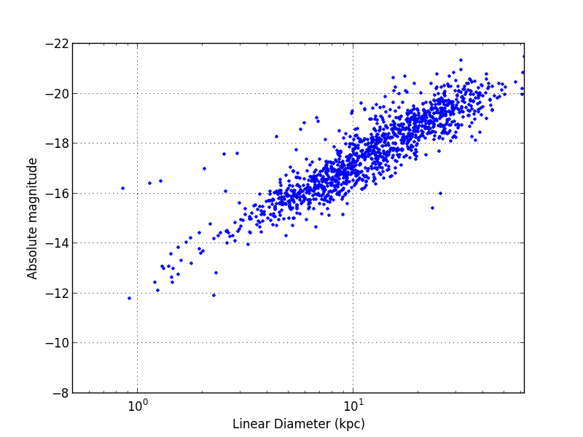
Ex: Magnitude - Diameter Relation
French et al. in prep

Slide 44
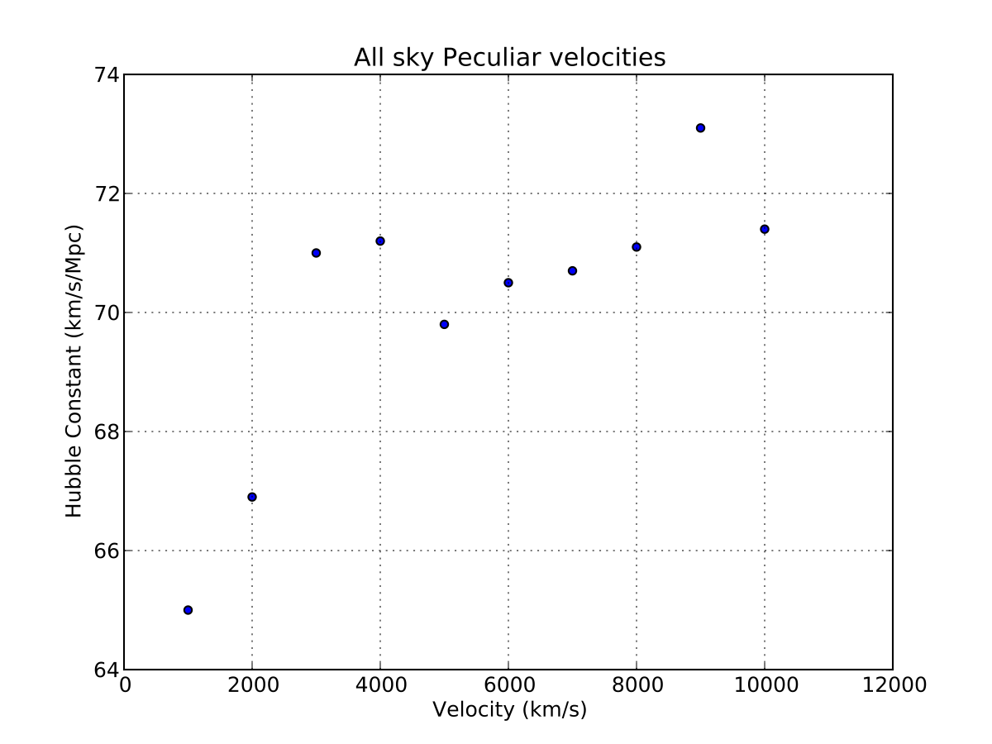
Local Distance Estimates: H₀ evolution
French et al. in prep

Slide 45
Additional Observations
Solving the absorber-galaxy rotation problem:
Obtain galaxy rotation velocities with WIYN and SALT
~400 galaxies * 0.1 highly inclined (>70°) = 40 targets
MaNGA & ASKAP – WALLABY (Wakker – CoI)
~1100 MaNGA galaxies within 2 Mpc of a COS sightline
WALLABY will map the 21cm sky out to cz = 60,000 km/s, providing rotation curves for all galaxies with dec <30°
Notes:
ONCE I HAVE REDUCE THE COS SIGHTLINES

Slide 46
Pilot Study
35 COS sightlines within 500 kpc of large galaxies
154 Lyα systems:
- 32% unambiguous galaxy pairings
- 51% are 500 kpc or 400 km/s away from a galaxy
- The remainder are ambiguous associations

Slide 47
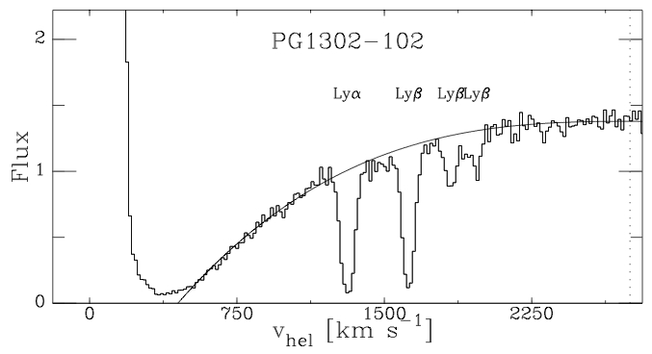
PG1302-102: Detected Absorption
French et al. in prep

Slide 48
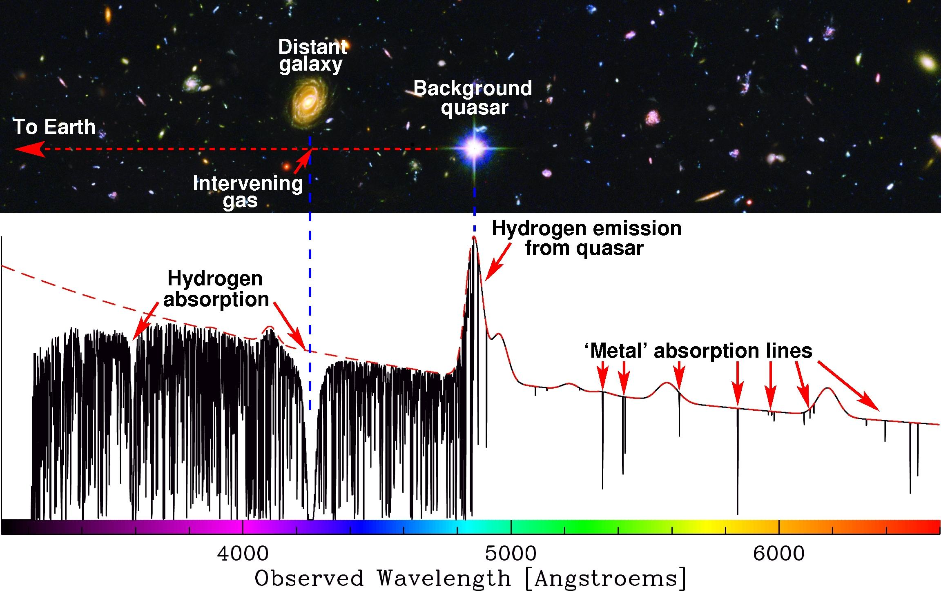
Method
Measure absorption in the foreground of a bright QSO:
Impact parameter
Image Credit: Michael Murphy & ESO

Slide 49
Example: PG1302-102 sightline
NGC4920
v = 1606 km/s
ρ = 468 kpc
Dec separation (kpc)
Velocity (km/s)
MCG-02-34-006
v = 1480 km/s
ρ = 404 kpc
6dFJ1310385-095554
v = 1436 km/s
ρ = 495 kpc
RA separation (kpc)
French et al. in prep
Notes:
Put velocities and impact parameters on this

Slide 50
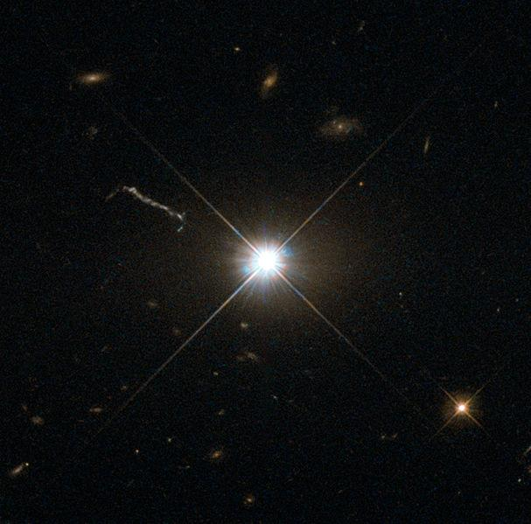
Pilot Study: Azimuth
Question: How does galaxy orientation correlate with detected absorption?
Credit: Bruce Hugo & Leslie Gaul, Adam Block, NOAO, AURA, NSF
QSO
Credit: ESA/NASA & Hubble

Slide 51
Pilot Study: Azimuth
Question: How does galaxy orientation correlate with detected absorption?
Azimuth =
Credit: Bruce Hugo & Leslie Gaul, Adam Block, NOAO, AURA, NSF
QSO
Credit: ESA/NASA & Hubble

Slide 52
Pilot Study: Azimuth
- Kacprzak et al. 2012 find azimuth dependence:
Blue = late type
Red = early type
Kacprzak et al. 2012

Slide 53
Pilot Study: Azimuth
I find:
Kacprzak et al. 2012:
Blue = late type
Red = early type
HI → Lyα
MgII
French et al. in prep
Kacprzak et al. 2012
Notes:
Label major and minor axis

Slide 54
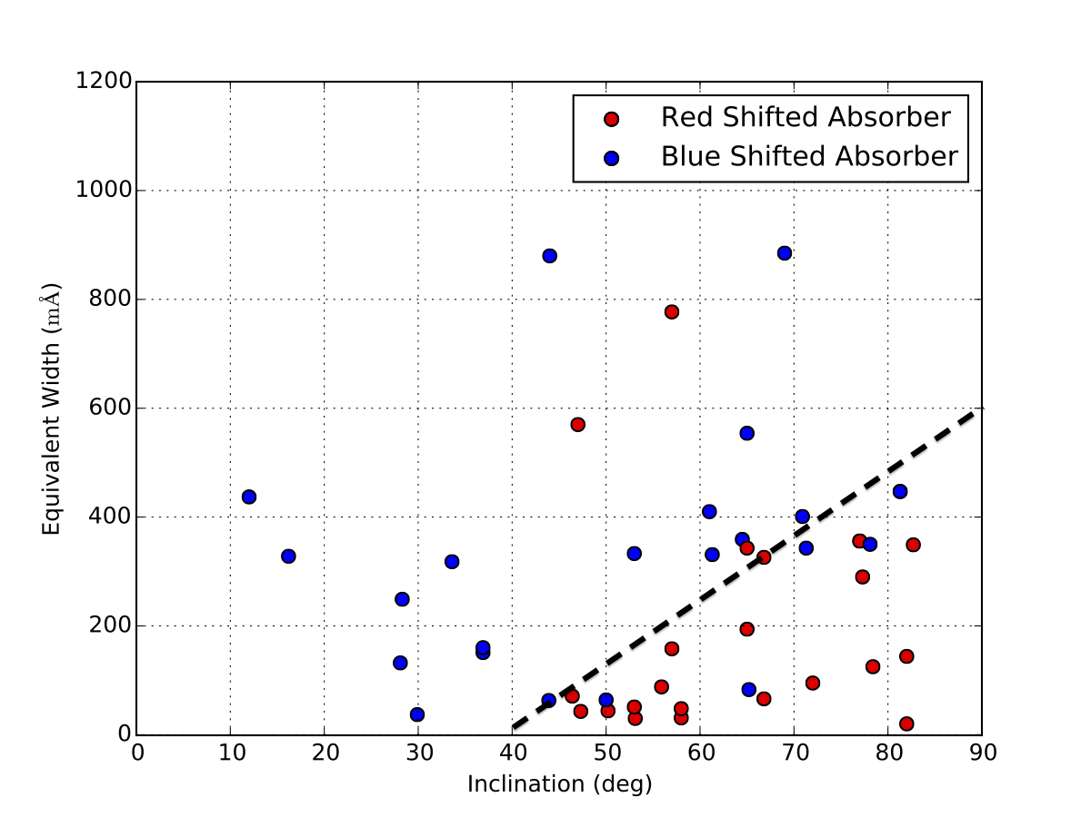
Pilot Study: Inclination
French et al. in prep

Slide 55
Pilot Study: Inclination
Difference:
W(redshifted) = 192 ± 10 mÅ
W(blue shifted) = 366 ± 14 mÅ
French et al. in prep

Slide 56
Pilot Study: Inclination
Difference:
W(redshifted) = 192 ± 10 mÅ
W(blue shifted) = 366 ± 14 mÅ
Possible inflows/outflows?
More analysis needed
French et al. in prep
Notes:
Possibly denser cold gas accreting along disk, and hot diffuse gas from feedback above the disk?

Slide 57
Summary
300+ archival COS sightlines to background QSOs
Local galaxy catalog (cz <= 10,000 km/s)
Additional WIYN and SALT observations
Four Questions:
Rotation
Inclination/orientation
Galaxy environment
Field vs group
Largest, most complete survey of the local CGM to date

Slide 58
Questions?
Nature 517, 444

Slide 59
Pilot Study: Inclination
French et al. in prep

Slide 60
Four Questions:
Do the properties of absorbers depend on the galaxy environment?
Do absorbers tend to follow galaxy rotation?
Is there a difference in detected absorption around field vs. group galaxies?
How does detected absorption depend on galaxy inclination?

Slide 61
Question 4:
How does detected absorption depend on galaxy inclination?
Bordoloi et al. 2014, ApJ, 784, 108

Slide 62
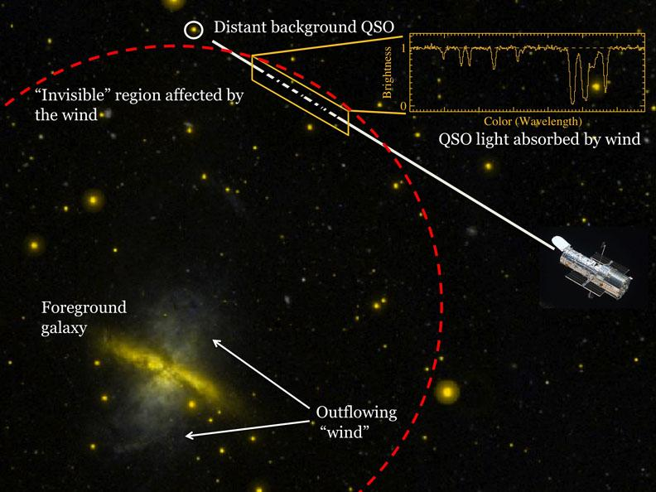
Method:
Image Credit: Todd Tripp & NASA GALEX

Slide 63
Outflow – (net redshift)
Inflow –
(net blueshift)

Slide 64
Inflow –
(net blueshift)

Slide 65
Pilot Study: Azimuth
I find:
- Bordoloi et al. 2014:
French et al. in prep
Bordoloi et al. 2014, ApJ, 784, 108

Slide 66
Pilot Study: Azimuth
- Bordoloi et al. 2014 predict absorption opening angle:
Bordoloi et al. 2014, ApJ, 784, 108

Slide 67
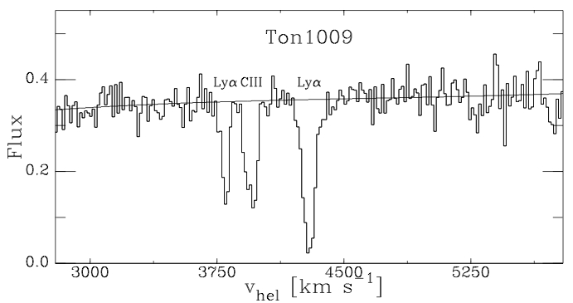
TON1009: Detected Absorption
French et al. in prep

Slide 68
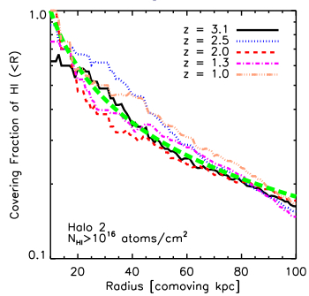
Do the properties of absorbers depend on the galaxy environment?
Simulations:
Gas covering fraction falls off quickly
Need more complete observational results
Stewart et al 2011
Notes:
NOT NECESSARY

Slide 69
Is there a difference in gas properties between field and group galaxies?
Yoon & Putman find no W – ρ correlation in the Virgo Cluster
Wakker & Savage find fewer Lyα absorbers near galaxy groups
Membership dependence?
New group catalogs (e.g. Tully 2015) necessitate a reevaluation
Yoon & Putman 2013
Notes:
Equivalent width – impact parameter correlation disappears in the Virgo Cluster environment. Hints at CGM suppression in cluster environments. How about smaller groups?

